Slide 1


2022 - Introduction to R Millennium Institute for Integrative Biology - iBio
Instructors:
Jonathan Maldonado, PhD
Nate Johnson, PhD
Pablo Villarreal, PhD
Tomás Moyano, PhD

Slide 2
Calendar of the course
Dia | Fecha |  | Hora | Content | Obligatorio
Viernes | 26 | Mayo | 11:00 | Q&A Section 1&2: R Basics | Required
Viernes | 02 | Junio | 11:00 | Q&A Section 3&4: R Basics
Viernes | 09 | Junio | 11:00 | Q&A Section 1&2&3: R Visualization
Viernes | 16 | Junio | 11:00 | Q&A Section 4&5: R Visualization & R Markdown
Viernes | 23 | Junio | 11:00 | Tarea 1 (due at 10:00am) | Required
Viernes | 07 | Julio | 11:00 | Q&A Section1: RNAseq Data Preprocessing | Required
Viernes | 14 | Julio | 11:00 | Q&A Section2: Temporal analysis of RNA-seq data | Required
Viernes | 21 | Julio | 11:00 | Q&A Section3: Treatment_and_Transcriptional Networks | Required
Viernes | 28 | Julio | 11:00 | Tarea 2 | Required
EDX
Nate Johnson
Jonathan Maldonado
Pablo Villarreal
Tomás Moyano

Slide 3
Strategies for solving problems
To program is to know how ”to google”
Google
How to google? Reserved characters (“”)
Stack Exchange
BioStars (for bioinformatics problems).
Advice from others… Usually useful, but maybe avoidable with a little googling.
Write me at nathan.johnson@mayor.cl or jax523@gmail.com.
Questions and answers session.
When you get good at R, you can understand your data much better!

Slide 4
Tips
Include a object type in the name of a variable! E.g. expression.df heights.vec categories.ls
Use descriptive variable names: abundance.df is much better than a.df (or worse ”a”).
You can use shorter names for a small section if you copy the object: a.df <- abundance.df
Use section dividers to clarify the sections of your script. (ctrl-shift-R windows, cmd-shift-R mac)
Do not use the terminal! Write everything in scripts and run from there. You will need to rerun code. This is your only record of what you did.
Use functions to organize your code - you can “wrap” discrete pieces of a script into a basic function.
The “#” character indicates comments – anything following this will not be evaluated. Tip: you can comment entire lines in R studio with (ctrl-shift-C windows, cmd-shift-C mac).
I will add more as we continue through the course

Slide 5
Tips
Use r-studio projects:
Configuration and function files.
Helps organize working directory.
I will add more as we continue through the course

Slide 6
Questions and Answers
Here, I can help any problems, confusion, questions, concerns – any other problems with the course material.
Share your difficulties! We can help others who are struggling!
Use the “raise hand” command, the chat, or speak up.

Slide 7
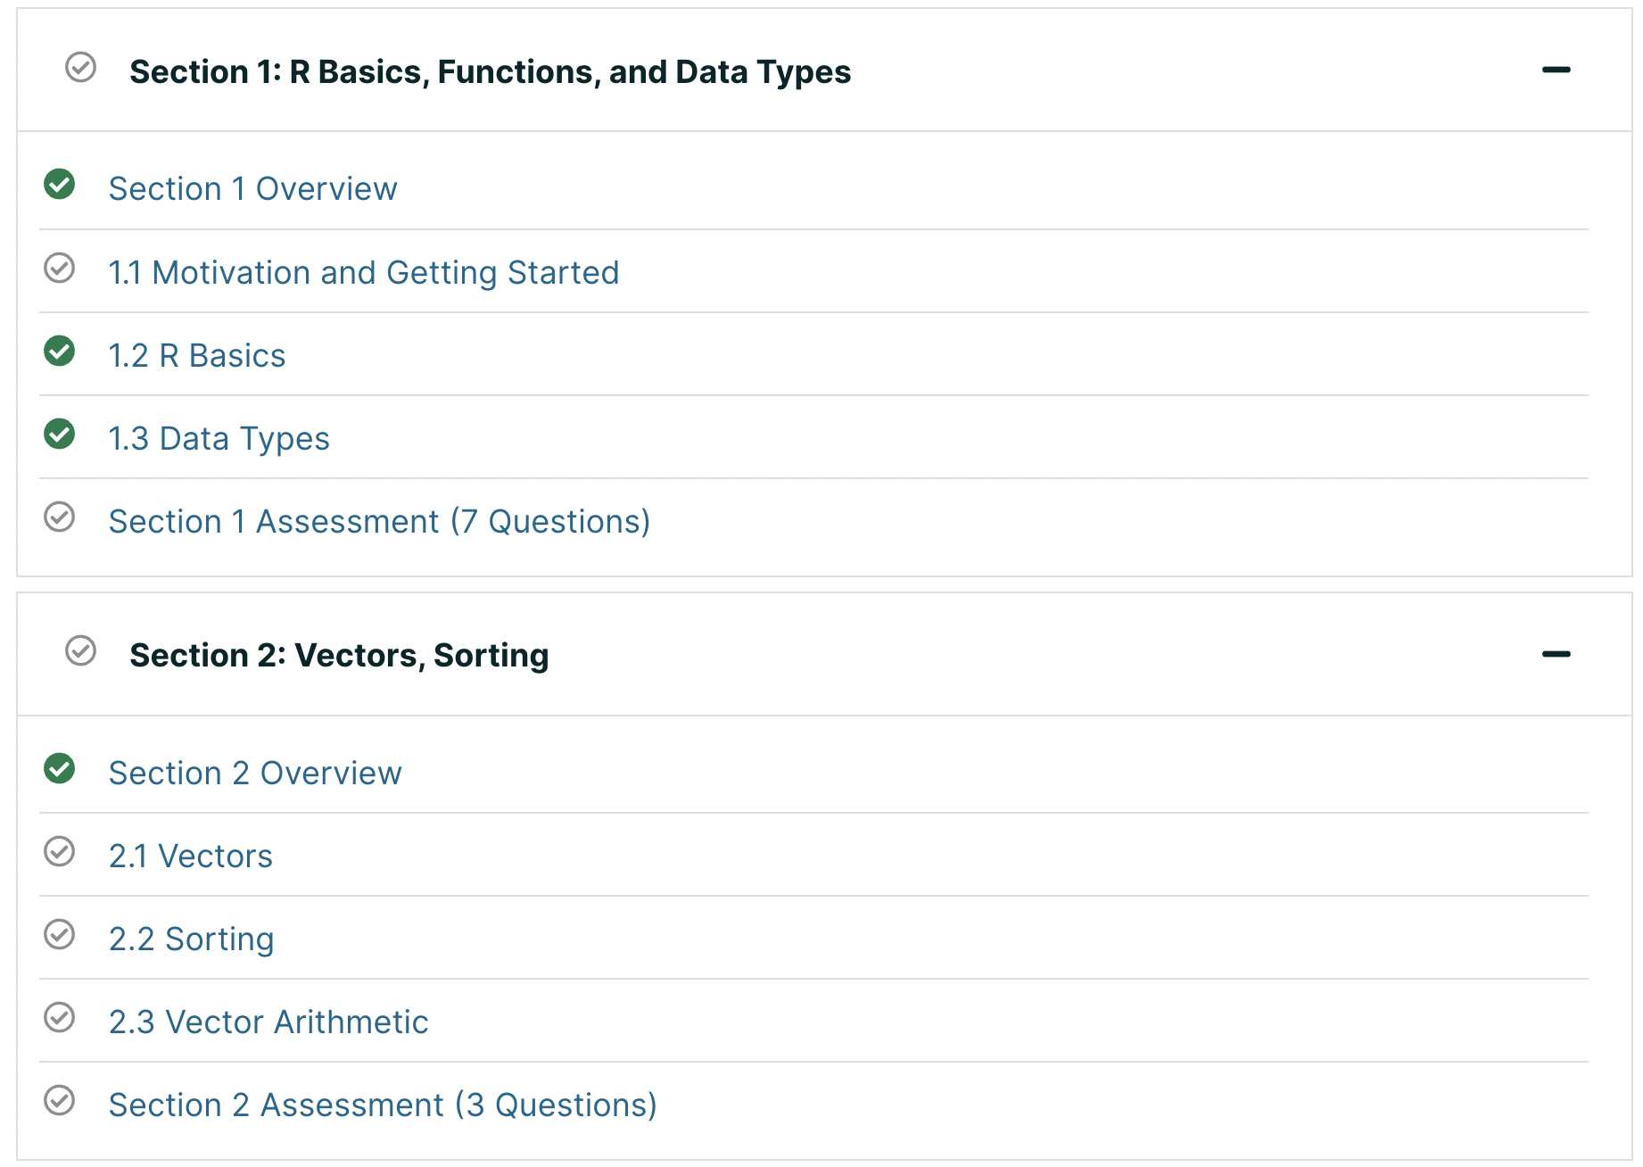
Week 1

Slide 8
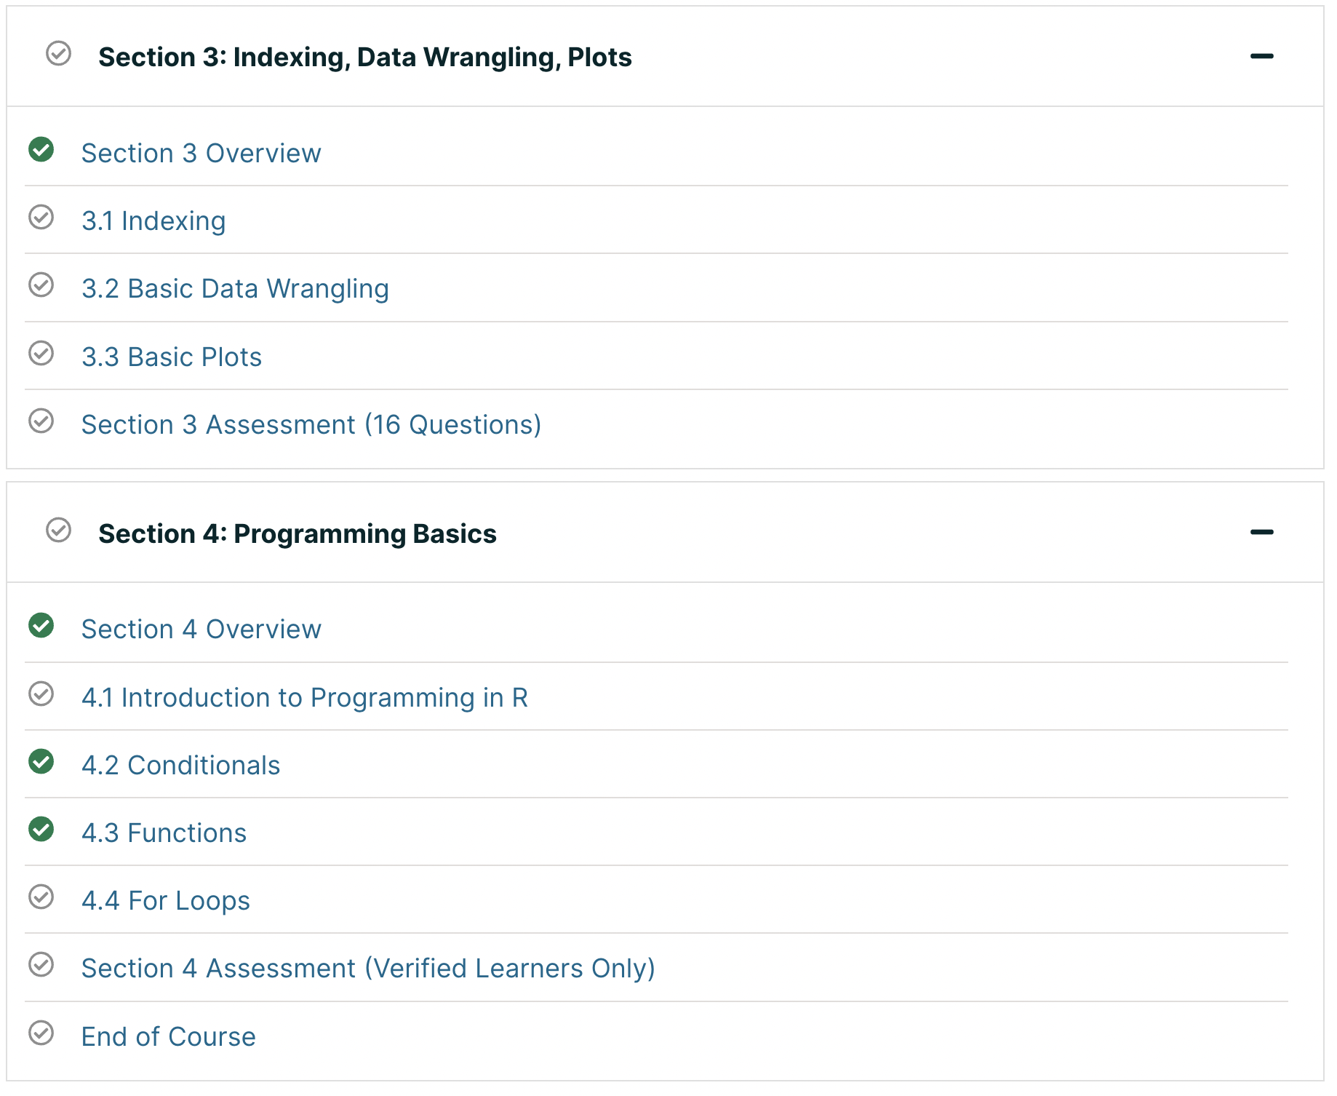
Week 2

Slide 9
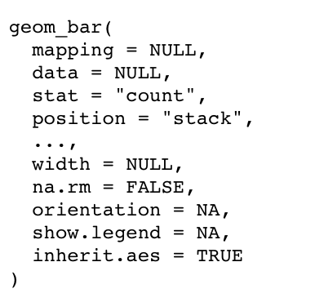
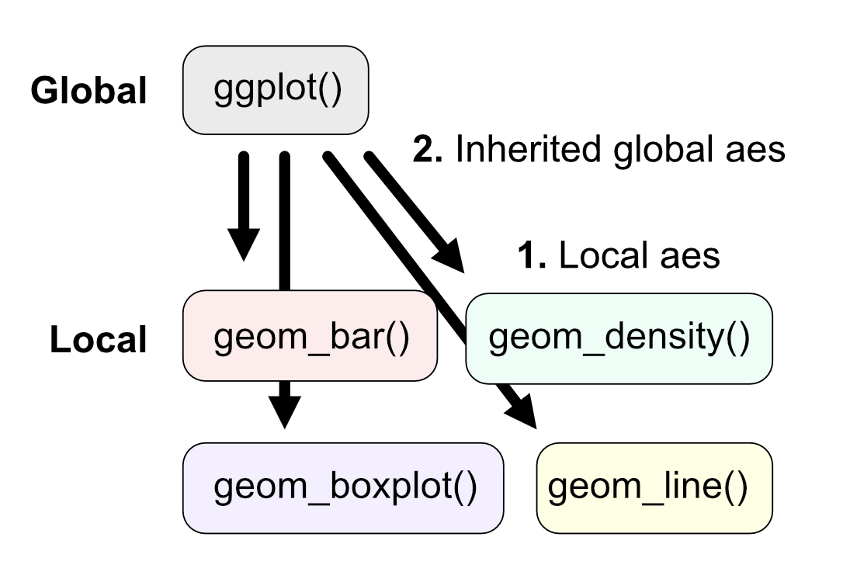
ggplot basics
Function options vs aes
Functions have built in options specific to them only (width, show.legend, na.rm).
Aes is the mapping variable, this can be shared between plotting functions and the parent plot.
Global vs local
Local and global ggplot functions have mappings (aes).
Locals can inherit these from the parent (global) mappings.
However, plot functions will use locally defined mappings first.

Slide 10
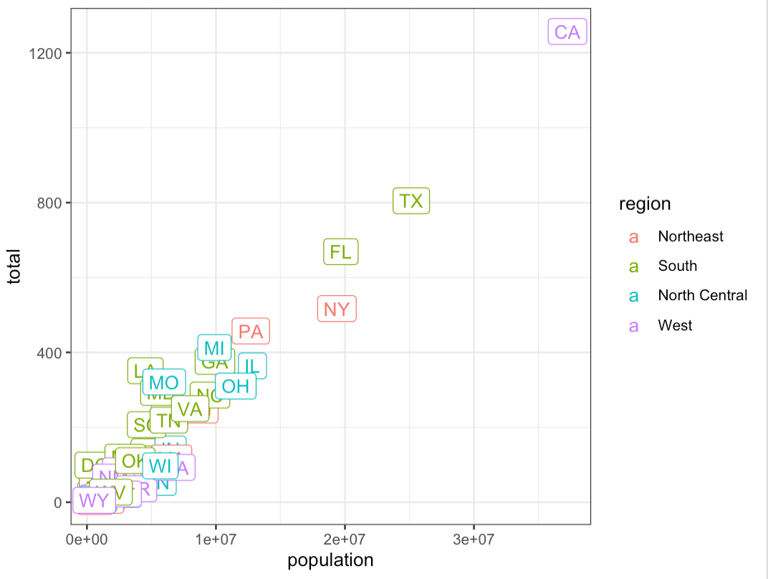
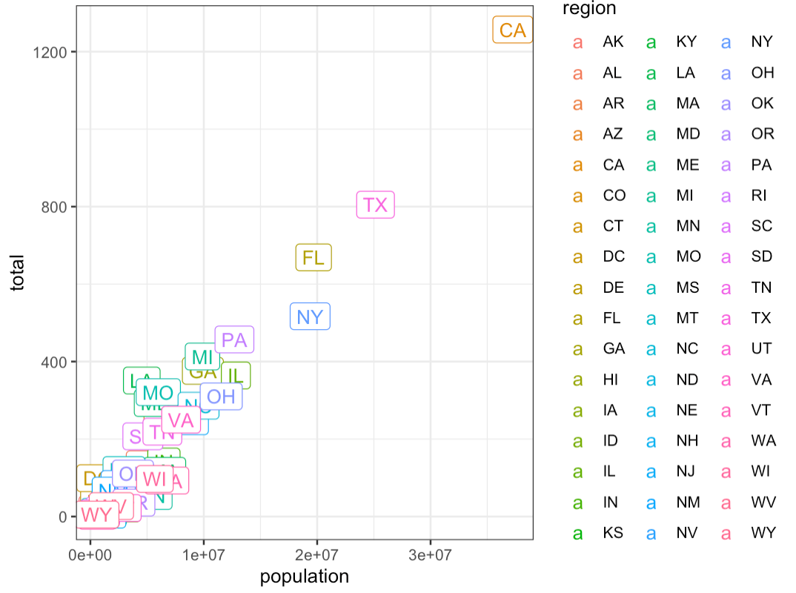
Global vs Local mappings
### Global invocation of color
murders %>% ggplot(aes(population, total, label = abb, color=region)) +
geom_label()
### Local "color" overrides global
murders %>% ggplot(aes(population, total, label = abb, color=region)) +
geom_label(aes(color=abb))

Slide 11
Helpful functions
Read in a table
read.delim()
Access (and write) row and column names of a data frame
row.names() col.names()
Vectorizing functions
This fills in for functions that don’t have vectorized equivalents mean() vs colMeans()
apply()
apply(input_table, direction, function)
Input table: a data frame
Direction: 1 – by rows, 2 – by columns
Function: any function you want to use
Apply(df, 1, mean) ~ rowMeans()

Slide 12
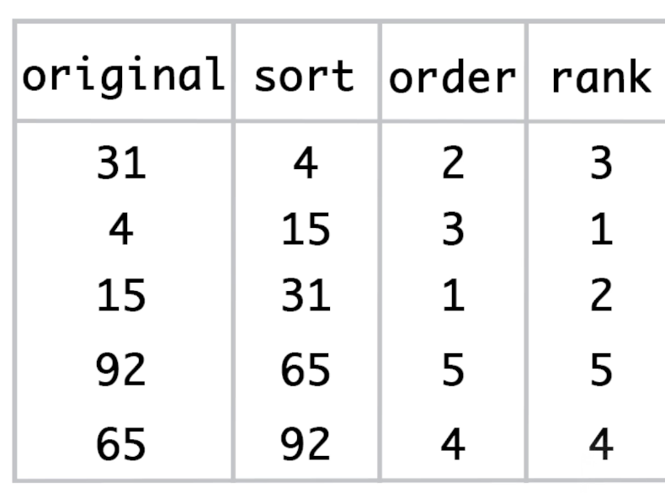
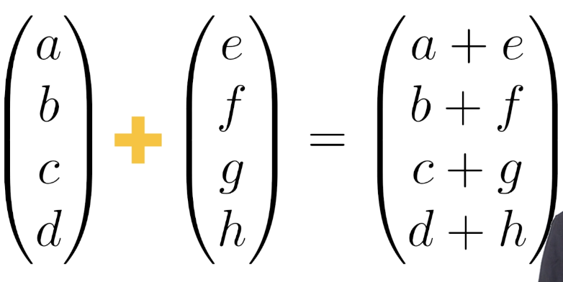
Vector arithmetic
Sorting/ordering functions

Slide 13
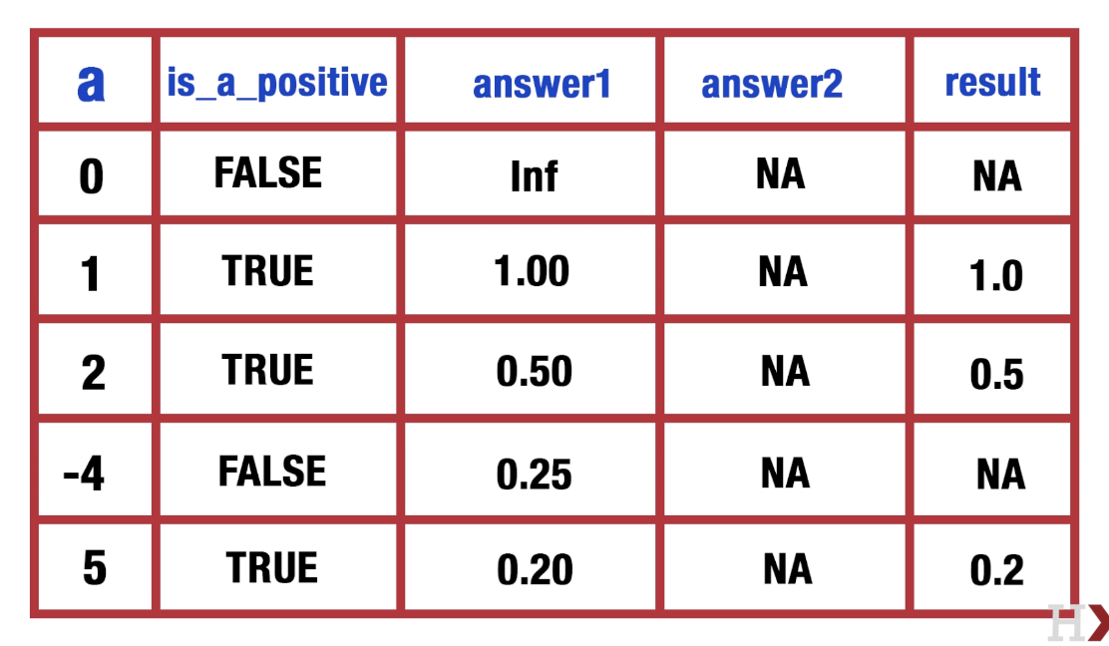

Slide 14
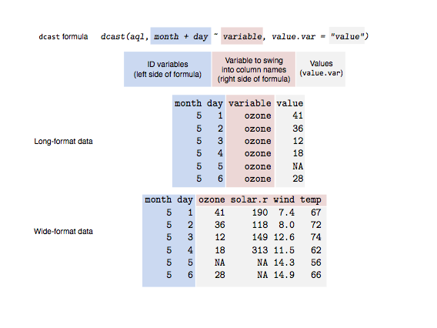
Data shape
reshape2 package
melt() Wide to Long
dcast() Long to Wide
aggregate() Long to wide (with aggregation)
https://seananderson.ca/2013/10/19/reshape/

Slide 15
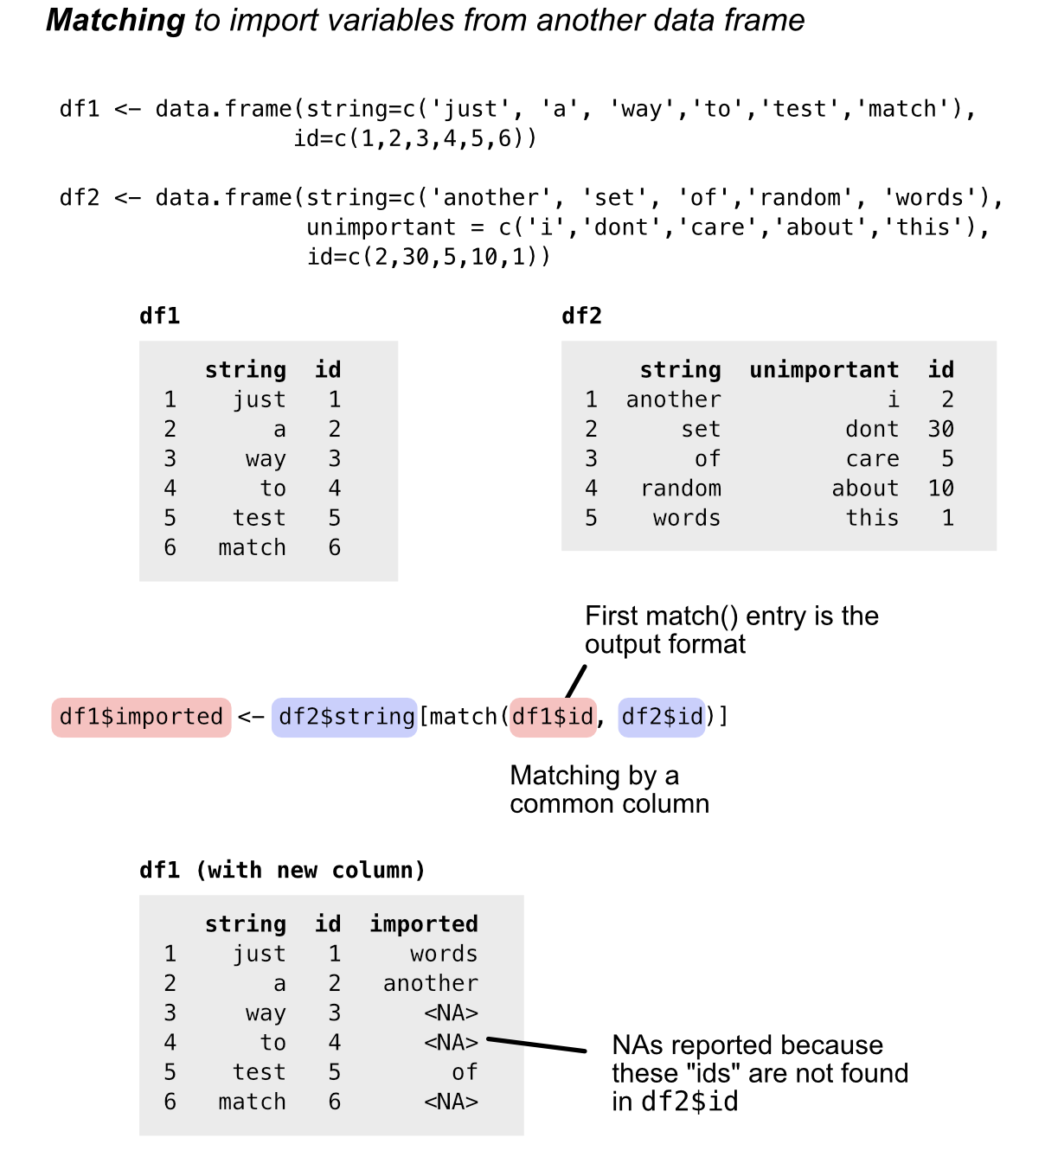

Slide 16
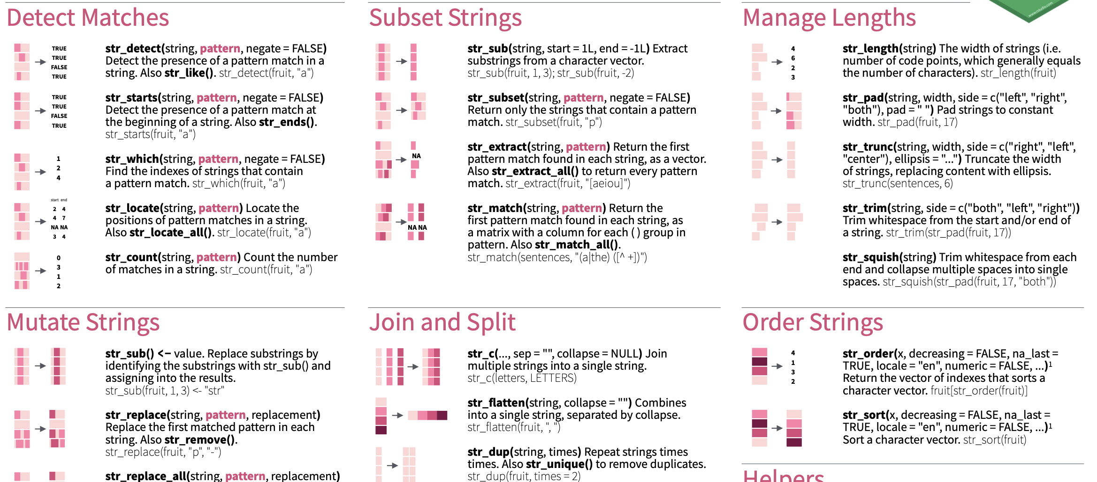
String manipulation
stringr package

Slide 17
Tarea (homework)
Homework 1
This will be shared via the public github page – we will write this in an email this weekend.
Need help? Write to me Nathan.johnson@mayor.cl
Homework should be submitted to a ”dropbox requests” folder:
https://www.dropbox.com/request/ksKczHquA6ZIJgCOfADQ
Aim of the homework:
Beginning steps for analyzing RNA-seq data.
Importing data -> processing it with functions and libraries -> generating basic plots
This is a chance to develop your own code to do these steps – this will be more difficult!
You will need to explore the right way to do things, use help documents (i.e. ?apply()) and google to solve this homework.
Date | Weekday | Action
May 13 | Friday | Homework assigned
May 20 | Friday | Homework help session
May 23 | Monday | Homework is due at 5:00pm

